Slide 1
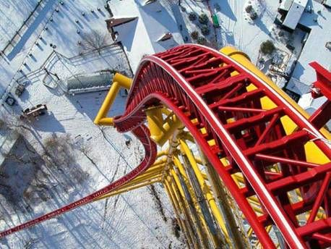
Conservation of Energy
This lesson will introduce you to law of conservation of energy
You will also learn how to use the law to solve problems that are
difficult to solve using kinematics.

Slide 2
Learning Goals
By the end of this lesson, you will be able to:
define mechanical energy
state the law of conservation of energy
solve problems involving conservation of energy
explain the meaning of unrecoverable energy

Slide 3
Success Criteria
Can I:
state and explain the law of conservation of energy
use the law of conservation of energy to solve energy questions
give examples of unrecoverable energy and explain why they are unrecoverable

Slide 4
Mechanical Energy
The total mechanical energy, E_{m}, is the sum of kinetic energy and gravitational potential energy.

Slide 5
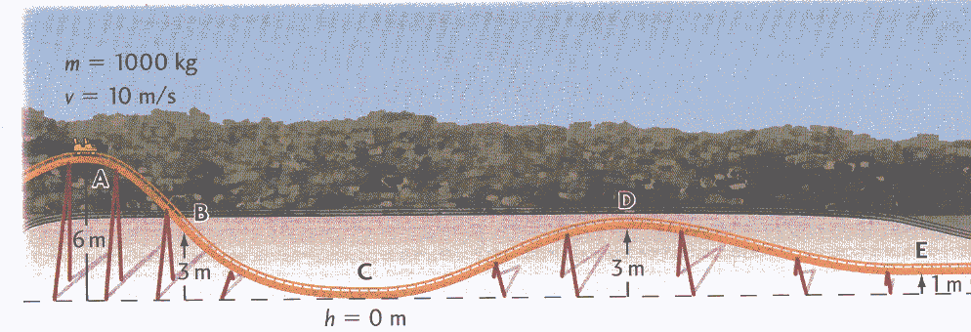
Law of Conservation of Energy
In an isolated system, the total amount of mechanical energy remains constant. Energy cannot be created or destroyed, only transferred from one form to another

Slide 6
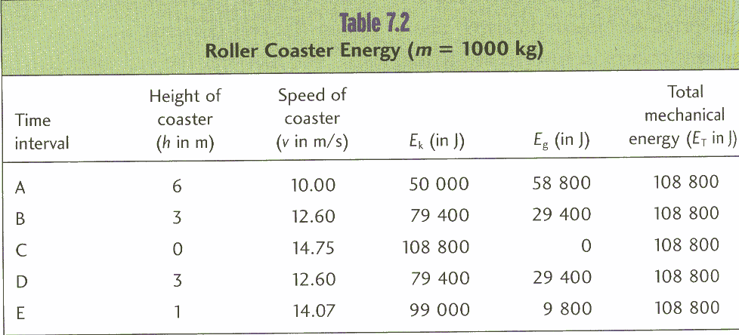
As the roller coaster E_{g} decreases and E_{k} increases
But, E_{m} remains constant

Slide 7
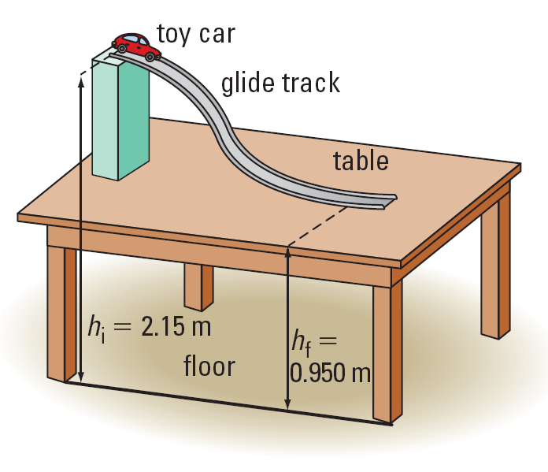
Sample Problem
A toy car of mass 25 g is placed on a track as shown in the diagram. Calculate the speed of the car at the bottom of the ramp, assuming friction is negligible

Slide 8
Sol’n:
We start by calculating the total energy at the top and bottom of the ramp
m = .025 kg
v_{i} = 0 m/s
h_{i} = 2.15 m
h_{f} =.950 m
v_{f} = ?

Slide 9
The LCE says E_{m@top} = E_{m@bot}
∴ the final speed is 4.9 m/s

Slide 10
HOMEWORK
Read Section 5.3
Review Tutorial 1
Questions 1 pg 241
1 – 4 pg 241

